Slide 1
Process Synchronization

Slide 2
Interprocess Communication
Processes within a system may be independent or cooperating
Cooperating process can affect or be affected by other processes, including sharing data
Reasons for cooperating processes:
  Information sharing
  Computation speedup
  Resources
  Shared Code
  Variables
Cooperating processes need interprocess communication (IPC)
Two models of IPC
  Shared memory
  Message passing
Notes:
https://www.tutorialspoint.com/cooperating-process

Slide 3

Communications Models

Slide 4
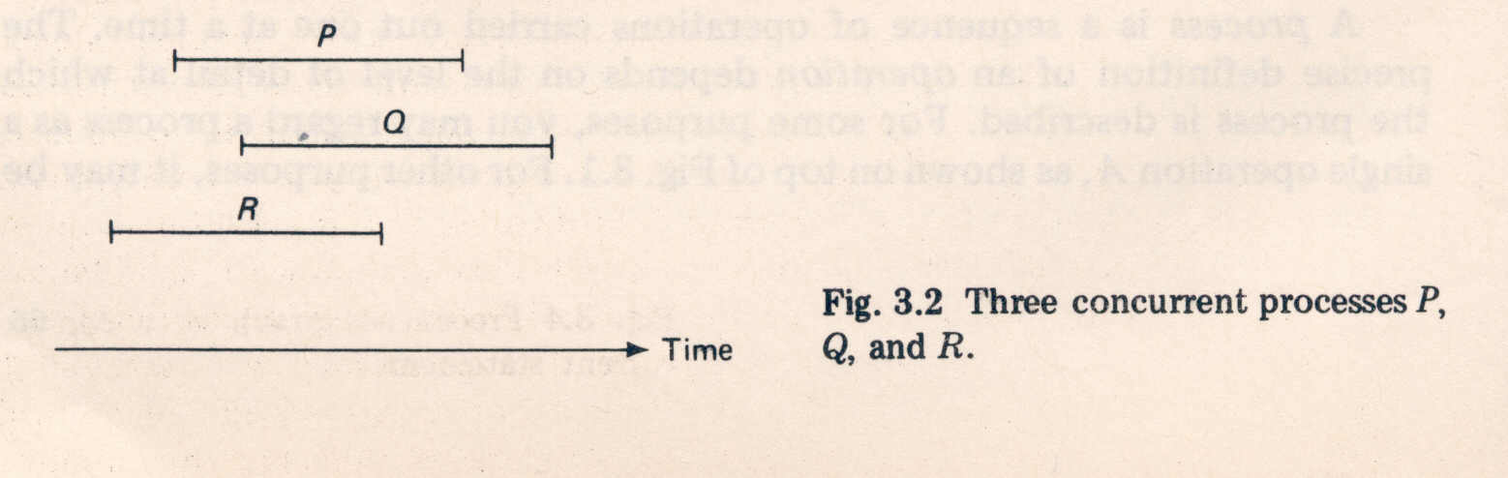
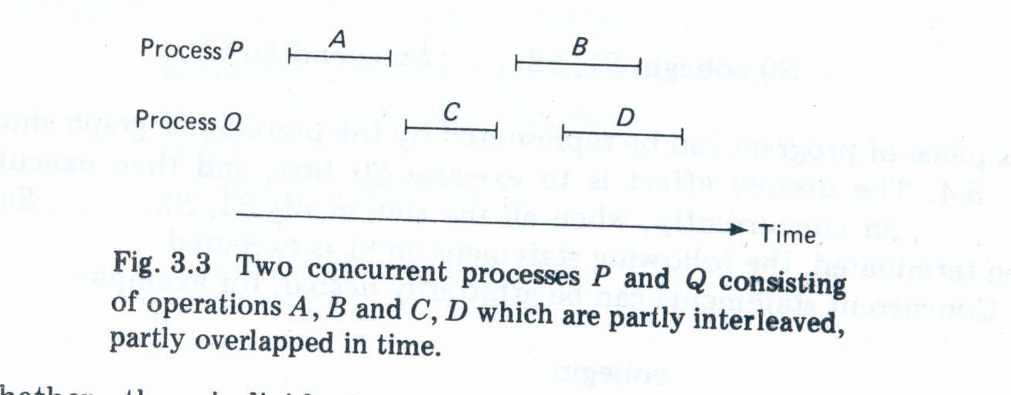
Concurrent Processes
Two processes are said to be concurrent if they over lap in their execution.

Slide 5
Introduction of Process Synchronization
counter++ could be implemented as:
register1 = counter
register1 = register1 + 1
counter = register1
counter-- could be implemented as:
register2 = counter
register2 = register2 – 1
counter = register2
Consider this execution interleaving with “count = 5” initially:
S0: producer execute register1 = counter {register1 = 5}
S1: producer execute register1 = register1 + 1 {register1 = 6}
S2: consumer execute register2 = counter {register2 = 5}
S3: consumer execute register2 = register2 – 1 {register2 = 4}
S4: producer execute counter = register1 {counter = 6 }
S5: consumer execute counter = register2 {counter = 4}
Race Condition

Slide 6
Critical Section Problem
Consider system of n processes {p0, p1, … pn-1}
Each process has critical section segment of code
Process may be changing common variables, updating table, writing file, etc
When one process in critical section, no other may be in its critical section
Critical section problem is to design protocol to solve this
Each process must ask permission to enter critical section in entry section, may follow critical section with exit section, then remainder section
Critical section is a code segment that can be accessed by only one process at a time.
Critical section contains shared variables which need to be synchronized to maintain consistency of data variables.

Slide 7
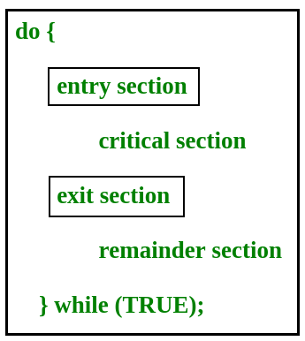
Critical Section Problem

Slide 8
Critical Section Problem
Any solution to the critical section problem must satisfy three requirements:
Mutual Exclusion: If a process is executing in its critical section, then no other process is allowed to execute in the critical section.
Progress : If no process is executing in the critical section and other processes are waiting outside the critical section, then only those processes that are not executing in their remainder section can participate in deciding which will enter in the critical section next, and the selection cannot be postponed indefinitely.
Bounded Waiting: A bound must exist on the number of times that other processes are allowed to enter their critical sections after a process has made a request to enter its critical section and before that request is granted.

Slide 9
Two process solution for critical section
First Solution: Boolean turn=0;
 | P₀ | P₁
 | while(1) { While(turn!=0); Turn=1; Remainder Section } | while(1) { While(turn!=1); Turn=0; }
Critical Section
Critical Section
Remainder Section
Remainder Section

Slide 10
Solution first is following Mutual Exclusion and fails to follow Progress as both process spin in some order that is both process can be executed one by one. Any Process P0 or P1 cannot be executed two times sequentially.

Slide 11
Two process solution for critical section
F | F
0 | 1
Second Solution: Boolean Flag[2]=
 | P₀ | P₁
 | while(1) { Flag[0]= T; while(flag[1]); flag[0]=F; } | while(1) { Flag[1]= T; while(flag[0]); flag[1]=F; }
Critical Section
Critical Section
Remainder Section
Remainder Section

Slide 12
Peterson’s Solution
Peterson’s Solution is a classical software based solution to the critical section problem.
In Peterson’s solution, we have two shared variables:
  boolean flag[i]: Initialized to FALSE, initially no one is interested in entering the critical section
  int turn : The process whose turn is to enter the critical section.

Slide 13
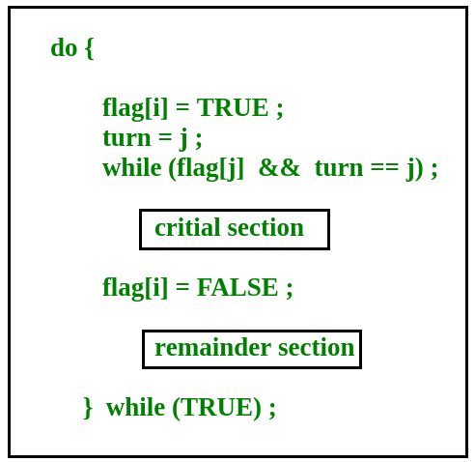
Peterson’s Solutions
i = 1-j

Slide 14

Two process solution for critical section
F | F
0 | 1
Second Solution: Boolean Flag[2]=
 | P₀ | P₁
 | while(1) { Flag[0]= T; Turn=1; while(turn==1 &&flag[1]==T); flag[0]=F; } | while(1) { Flag[1]= T; Turn=0 while(turn==0 &&flag[0]==T); flag[1]=F; }
Critical Section
Critical Section
Remainder Section
Remainder Section

Slide 15



Semaphore
Semaphore was proposed by Dijkstra in 1965 to manage concurrent processes by using a simple integer value, known as a semaphore.
Semaphore is simply an integer variable which is non-negative and shared between threads.
This variable is used for critical section in the multiprocessing environment.
It uses two basic function wait(S) and Signal(S).
wait (S):
while S≤ 0 do no-op;
S--;
signal (S):
S++;

Slide 16
Critical Section of n Processes
Shared data:
semaphore mutex; //initially mutex = 1
Process Pi:
do {
wait(mutex);
critical section
signal(mutex);
remainder section
} while (1);
wait (S):
while S≤ 0 do no-op;
S--;
signal (S):
S++;

Slide 17


Two Types of Semaphores
Binary Semaphore – This is also known as mutex lock. It can have only two values – 0 and 1. Its value is initialized to 1. It is used to implement the solution of critical section problem with multiple processes.
Counting Semaphore – Its value can range over an unrestricted domain. It is used to control access to a resource that has multiple instances
Can implement a counting semaphore S as a binary semaphore.

Slide 18
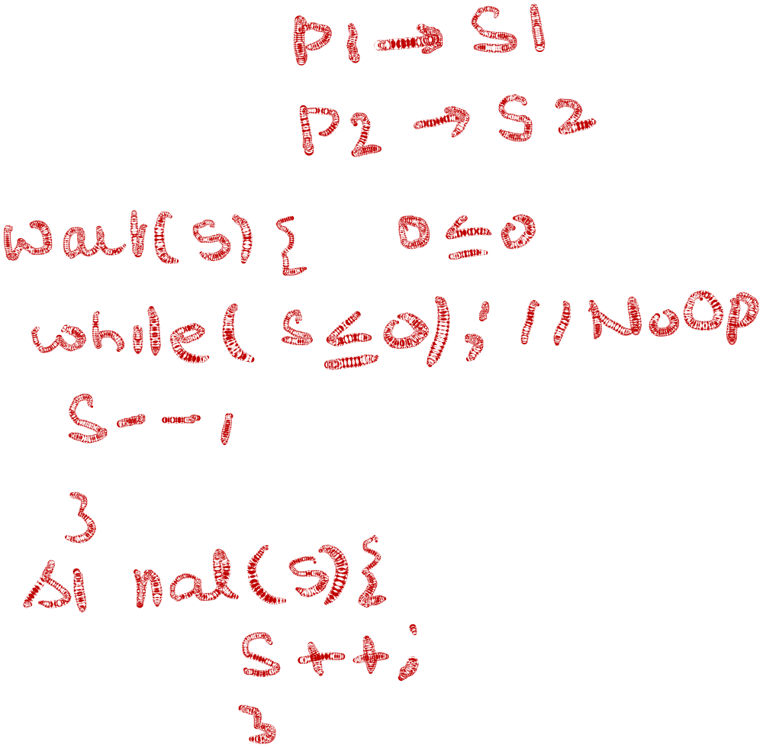




Example
There are TWO Processes P1 with Statement S1 and P2 with S2
CONDITION : S2 be executed only after S1. ( S1 →S2)
Semaphore synch←0;
        _______________________
        S1;
        Signal(synch);
        _______________________
        Wait(synch);
        S2;
        ________________________

Slide 19
Classical Problems of Synchronization
Producer Consumer with Bounded-Buffer Problem
Readers and Writers Problem
Dining-Philosophers Problem
Operating System Concepts

Slide 20
Producer Consumer with Bounded-Buffer
We have a buffer of fixed size.
A producer can produce an item and can place in the buffer.
A consumer can pick items and can consume them.
We need to ensure that when a producer is placing an item in the buffer, then at the same time consumer should not consume any item.
In this problem, buffer is the critical section.
To solve this problem, two counting semaphores – Full and Empty.
“Full” keeps track of number of items in the buffer at any given time and “Empty” keeps track of number of unoccupied slots.

Slide 21

Producer Consumer with Bounded-Buffer
Shared data : semaphore full, empty, mutex;
Initially: full = 0, empty = n, mutex = 1
do {
…
produce an item in nextp
…
wait(empty);
wait(mutex);
…
add nextp to buffer
…
signal(mutex);
signal(full);
} while (1);
do {
wait(full)
wait(mutex);
…
remove an item from buffer to nextc
…
signal(mutex);
signal(empty);
…
consume the item in nextc
…
} while (1);

Slide 22



Readers-Writers Problem
semaphore mutex, wrt;
Initially mutex = 1, wrt = 1, readcount = 0
wait(mutex);
readcount++;
if (readcount == 1)
wait(rt);
signal(mutex);
…
reading is performed
…
wait(mutex);
readcount--;
if (readcount == 0)
signal(wrt);
signal(mutex):
wait(wrt);
…
writing is performed
…
signal(wrt);

Slide 23








Dining-Philosophers Problem
Shared data
semaphore chopstick[5];
Initially all values are 1

Slide 24
Dining-Philosophers Problem
Philosopher i:
do {
wait(chopstick[i])
wait(chopstick[(i+1) % 5])
…
eat
…
signal(chopstick[i]);
signal(chopstick[(i+1) % 5]);
…
think
…
} while (1);

Slide 25


